Slide 1
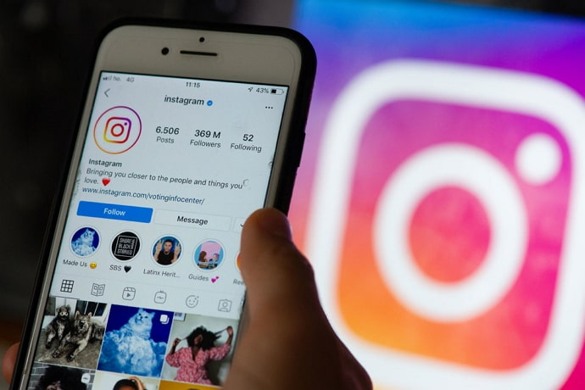
INSTAGRAM FAKE ACCOUNT DETECTION

Slide 2

ABOUT TOPIC
In the current era, presence on social media has become part and parcel of life. Instagram is one of the widely used emerging social platforms, having an active user count of around 1 billion. In a survey, it has been found that one in ten accounts on Instagram is fake In this project, we will describe our Machine Learning approach to detect and classify fake accounts on Instagram. Real accounts are those accounts that are active, having profile pictures, nicely written biographies with a legible username, and media posts Fake Account: Fake accounts are those accounts that usually contain strange names, very little follower count The main intention behind the creation of such accounts is to increase the popularity metrics of some users by increasing their followers. These accounts are created in bulk using automated tools.

Slide 3
UNDERSTAND THE PROBLEM STATEMENT AND BUSINESS CASE
We collected some data to predict whether that particular account is fake or not. Input features: 1. Profile pic 2. Length_username 3. Fullname_words 4. Fullname_length 5. Name_username 6. Bioinfo_length 7. External_url 8. Private 9. No of post 10. No of followers 11. No of following Output feature: 1. Output Label: (x) Is Fake (0 means real, 1 means fake)

Slide 4
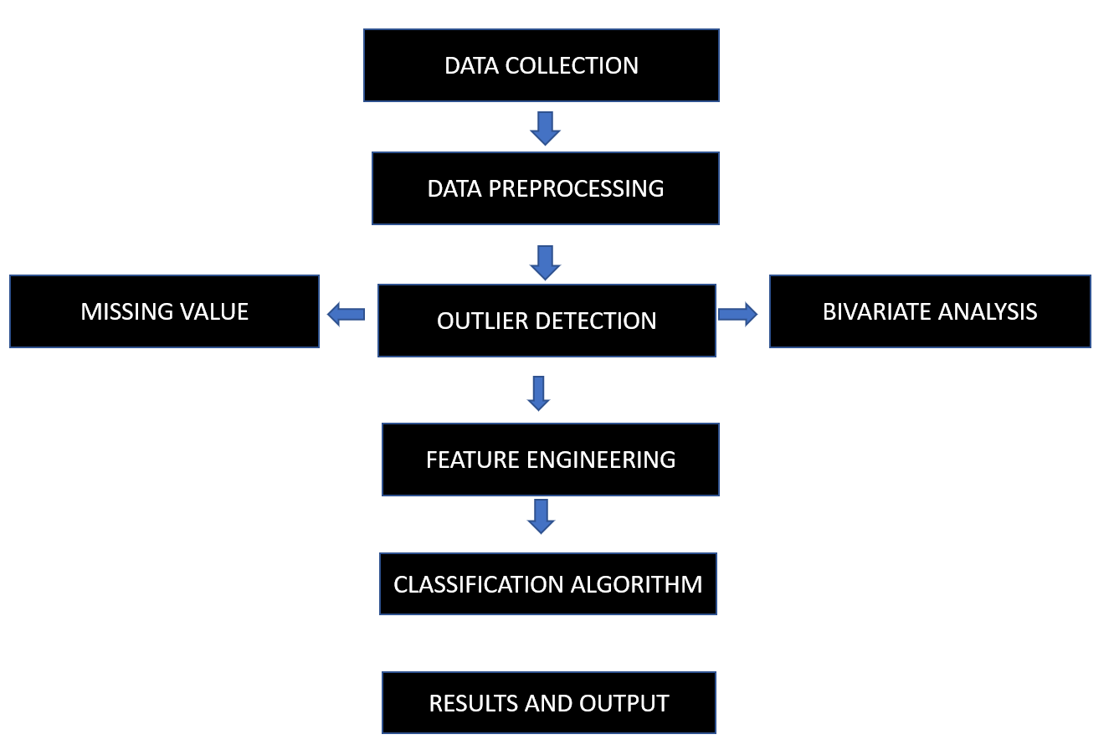
UNDERSTAND THE PROBLEM STATEMENT AND BUSINESS CASE

Slide 5
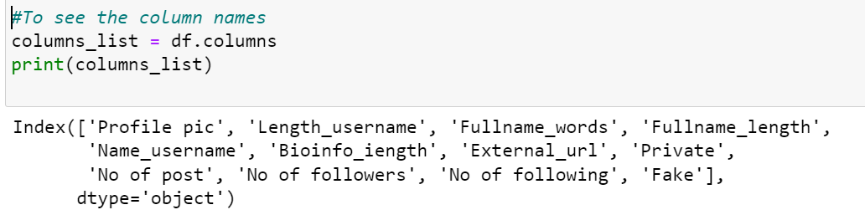
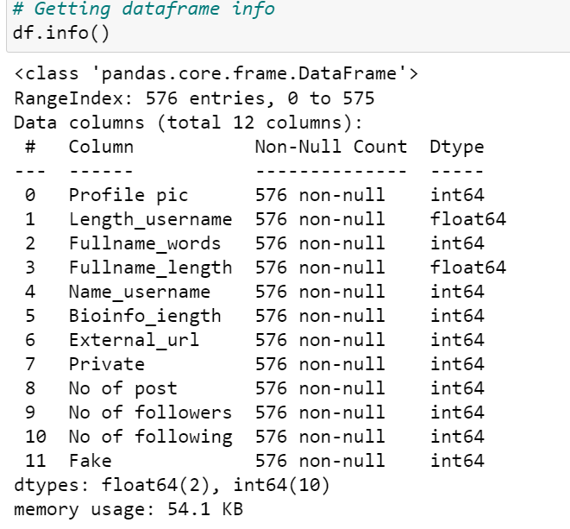
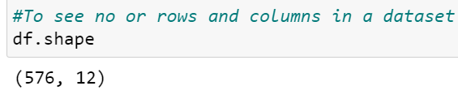
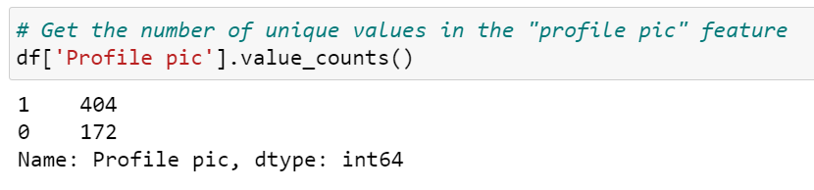
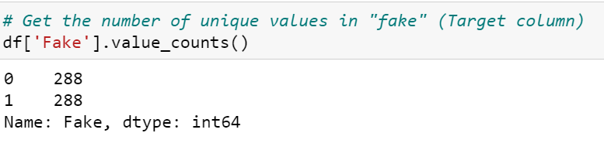
DATASET EXPLORATION

Slide 6
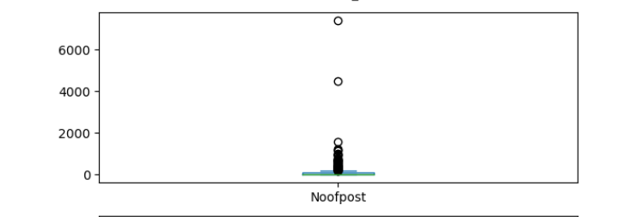
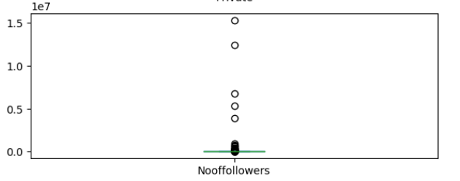
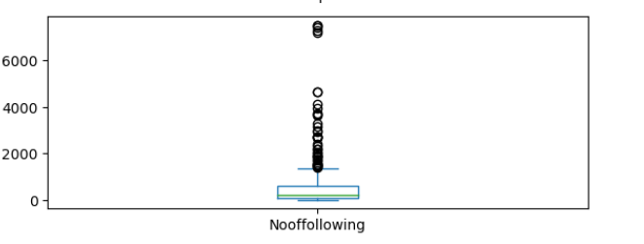
DATA PREPROCESSING
OUTLIER DETECTION -BOXPLOT Outliers found in 3 variables No of post No of following No of followers

Slide 7
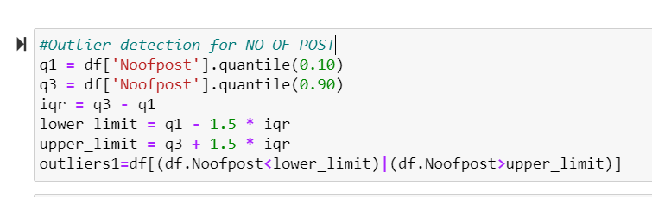
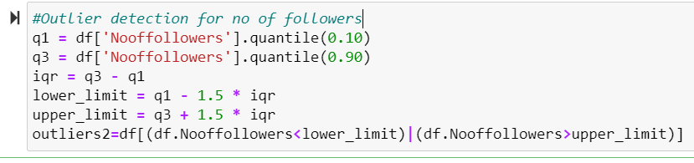
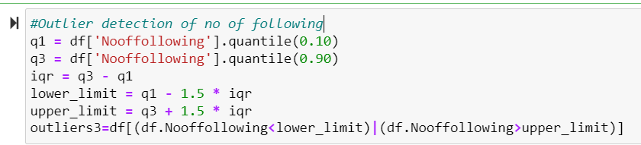
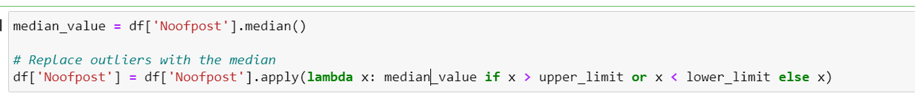
DATA PREPROCESSING
REMOVING OUTLIERS-IQR METHOD REPLACE OUTLIERS WITH THE MEDIAN

Slide 8
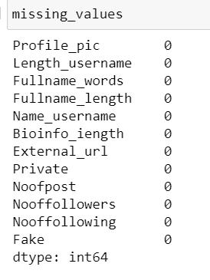
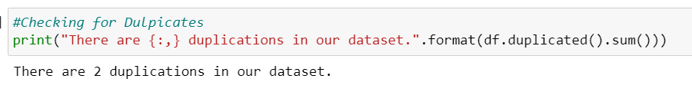
DATA PREPROCESSING
2.FINDING MISSING VALUES 3.DUPLICATE VALUES

Slide 9
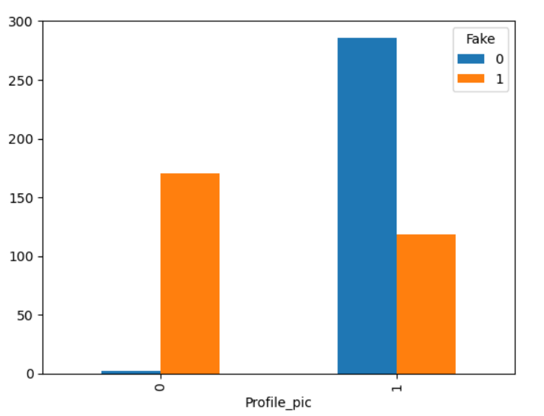
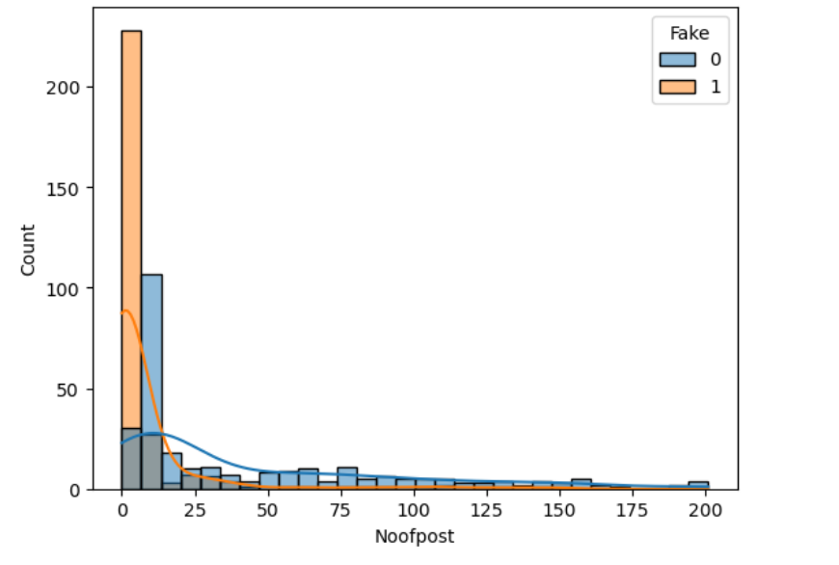
DATA VISUALIZATION
The account having no profile picture showing more fake accounts 2. The account having less no of post showing more fake accounts.

Slide 10
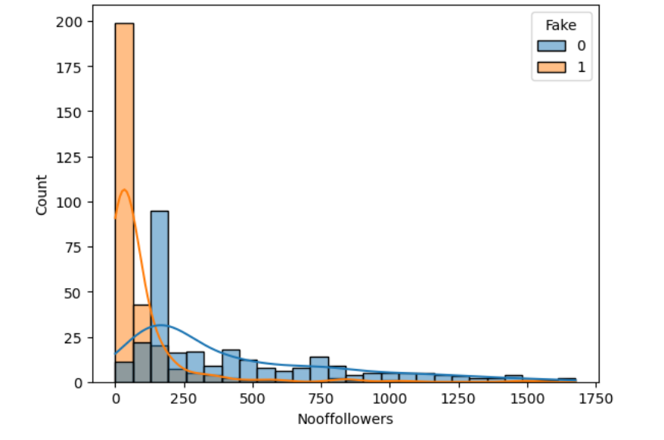
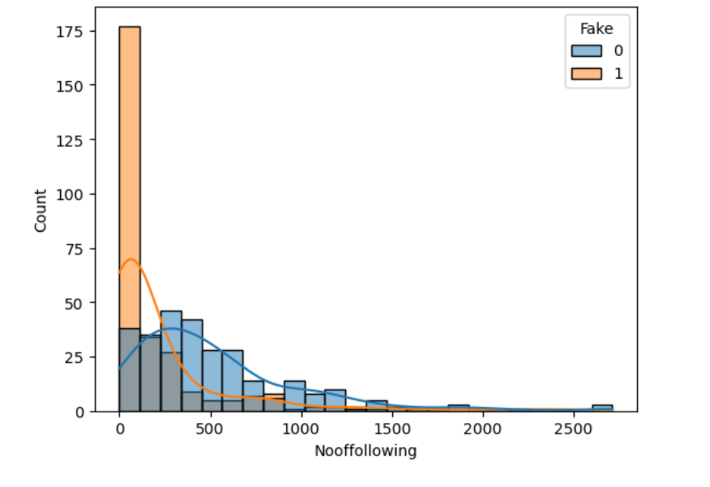
DATA VISUALIZATION
The account having less no of followers showing more fake accounts 2. The account having less no of following showing more fake accounts.

Slide 11
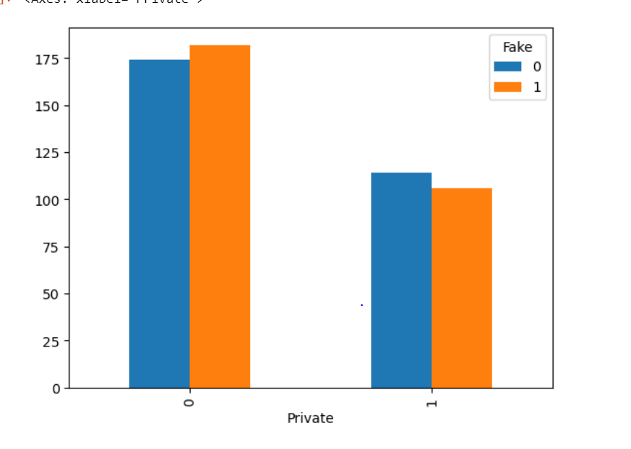
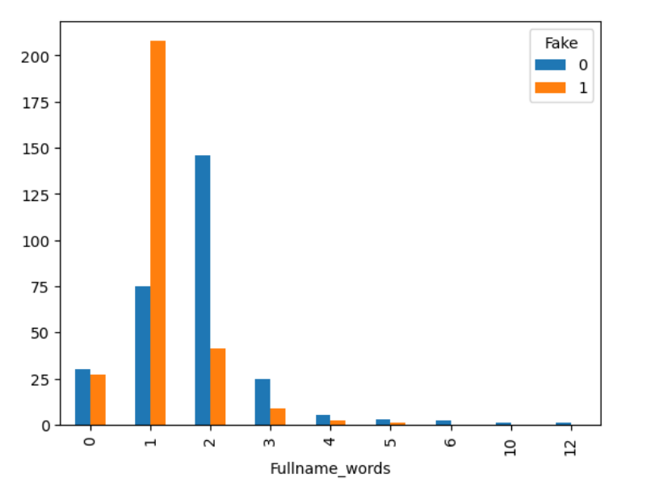
DATA VISUALIZATION
The account which is private showing more fake accounts 2. The account having two name words showing more fake accounts.

Slide 12
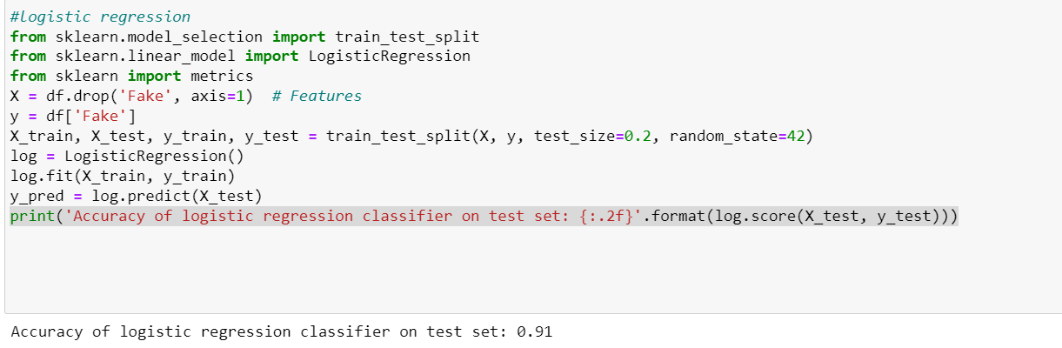
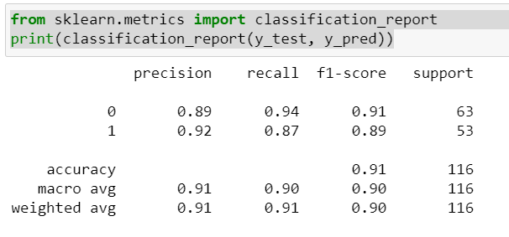
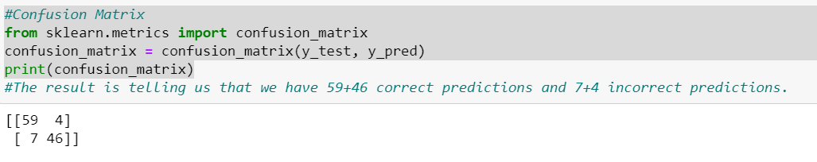
MODEL BUILDING
LOGISTIC REGRESSION

Slide 13
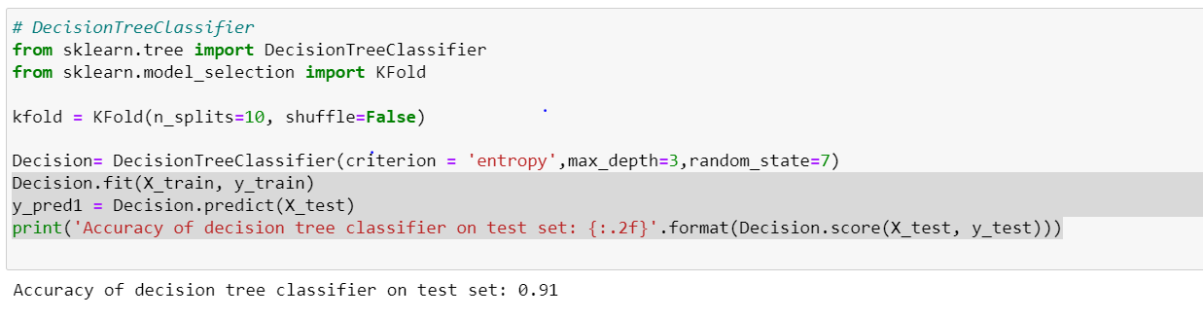
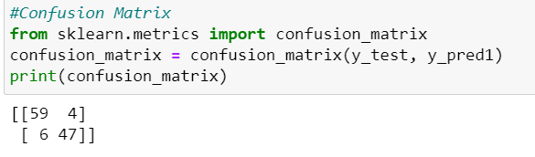
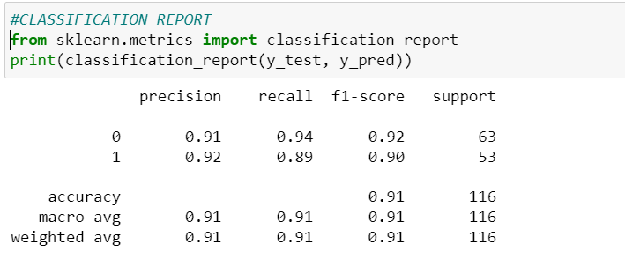
MODEL BUILDING
2.DECISION TREE CLASSIFIER

Slide 14
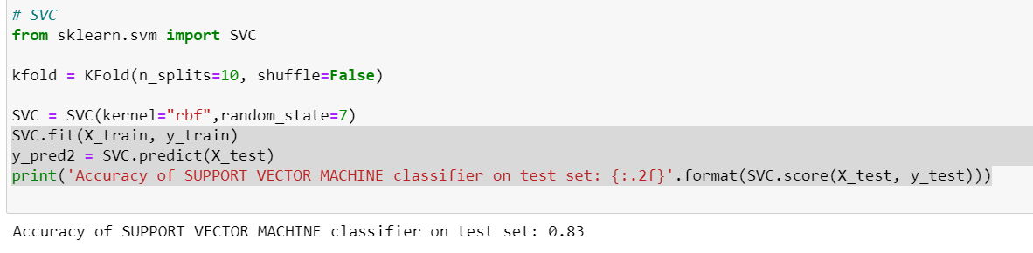
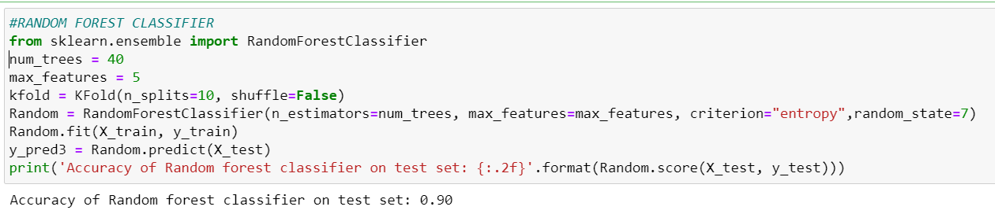
MODEL BUILDING
3.SUPPORT VECTOR MACHINE 4.RANDOM FOREST CLASSIFIER

Slide 15
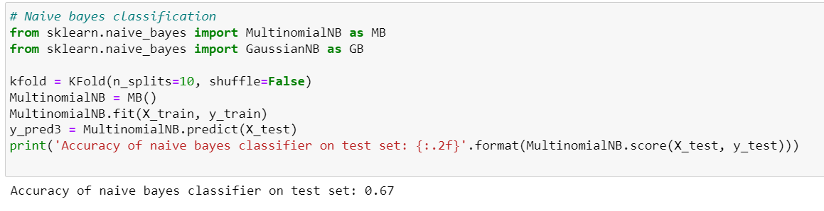
MODEL BUILDING
5.NAIVE BAYERS LOGISTIC REGRESSION CLASSIFIER, WITH 91% ACCURACY IS SELECTED AS THE FINAL MODEL.

